Slide 1

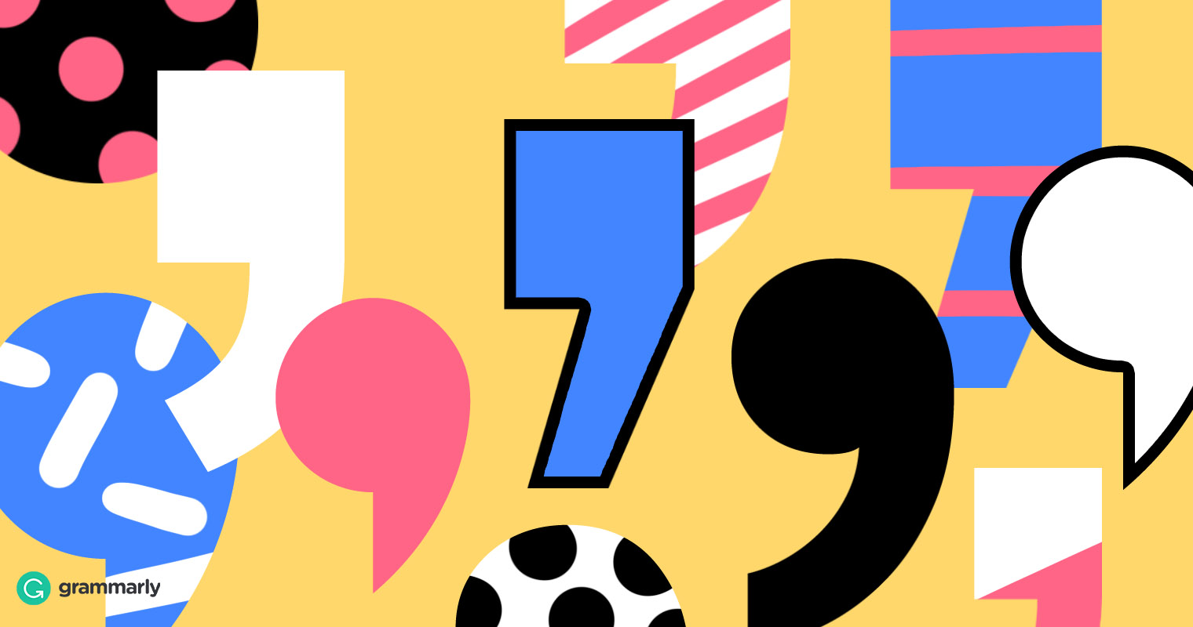
Progression in the
use of commas
(Y1 – Y6)
Department of Children’s Services

Slide 2
Y1
No use of commas

Slide 3
Y2
Commas to separate items in a list . . .
Little Red Riding Hood took eggs, butter, biscuits and flowers to her grandma.

Slide 4
Y3
Commas to separate items in a list . . .
Little Red Riding Hood took eggs, butter, biscuits and flowers to her grandma.

Slide 5
Y4
Commas to separate items in a list . . .
Little Red Riding Hood took eggs, butter, biscuits and flowers to her grandma.

Slide 6
Y4
Comma before or after a
reporting clause in direct speech . . .
“What big ears you’ve got,” said Little Red Riding Hood.
Little Red Riding Hood said, “What big ears you’ve got.”

Slide 7
Y4
Comma after a fronted adverbial. . .
When Little Red Riding Hood saw that the wolf had dressed up in Grandma’s clothes, she ran as fast as she could out of the cottage and back through the wood.

Slide 8
Y5
Commas to separate items in a list . . .
Little Red Riding Hood took eggs, butter, biscuits and flowers to her grandma.

Slide 9
Y5
Comma before or after a
reporting clause in direct speech . . .
“What big ears you’ve got,” said Little Red Riding Hood.
Little Red Riding Hood said, “What big ears you’ve got.”

Slide 10
Y5
Comma after a fronted adverbial. . .
When Little Red Riding Hood saw that the wolf had dressed up in Grandma’s clothes, she ran as fast as she could out of the cottage and back through the wood.

Slide 11
Y5
Commas to indicate parenthesis . . .
The wolf, who was dressed in Grandma’s clothes, leered at Little Red riding Hood as she entered the cottage.

Slide 12
Y5
Commas to avoid ambiguity . . .
“Let’s eat, Grandma,” said Little Red Riding Hood.

Slide 13
Y6
Commas to separate items in a list . . .
Little Red Riding Hood took eggs, butter, biscuits and flowers to her grandma.

Slide 14
Y6
Comma before or after a
reporting clause in direct speech . . .
“What big ears you’ve got,” said Little Red Riding Hood.
Little Red Riding Hood said, “What big ears you’ve got.”

Slide 15
Y6
Comma after a fronted adverbial. . .
When Little Red Riding Hood saw that the wolf had dressed up in Grandma’s clothes, she ran as fast as she could out of the cottage and back through the wood.

Slide 16
Y6
Commas to indicate parenthesis . . .
The wolf, who was dressed in Grandma’s clothes, leered at Little Red riding Hood as she entered the cottage.

Slide 17
Y6
Commas to avoid ambiguity . . .
“Let’s eat, Grandma,” said Little Red Riding Hood.

