Slide 1

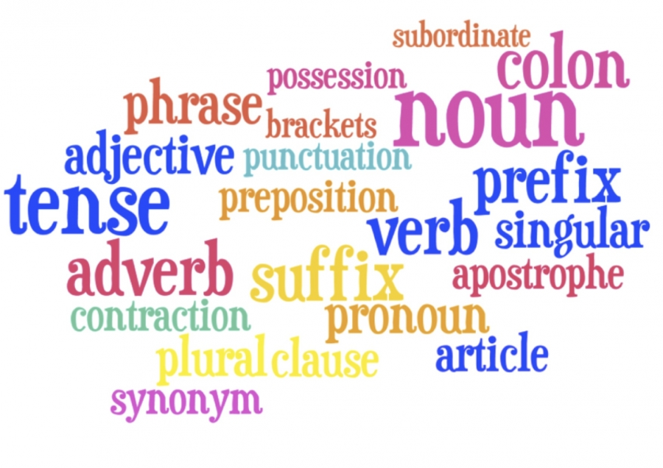
Progression in grammar
and punctuation
(Y1 – Y6)
Department of Children’s Services

Slide 2
Y1
The man fell.
The man fell. He hurt his knee.
The man fell and he hurt his knee.
How did the man fall ?
The man fell !
Who ?
What doing ?
Finger space
Capital letter
Full stop
Joining word and
Question mark
Exclamation mark

Slide 3
Y2
The clumsy man fell and he hurt his knee.
Expanded noun phrase
The man fell but he didn’t hurt himself.
The man fell but he didn’t hurt his arm or his leg.
The man fell because the ladder wasn’t safe.
The man fell when he slipped on the ladder.
The man fell off the ladder that he hadn’t put safely against the wall.
The man will fall off the ladder if it isn’t safe.
Co-ordinating conjunctions and, but, or
Subordinating conjunctions because, when, that, if
Apostrophe for contraction

Slide 4
Y2
How did the man fall ?
The man fell !
Question mark
Exclamation mark
The man hurt his head, his arm, his knee and his ankle when he fell off his ladder.
Commas to separate items in a list.
The man’s knee hurt when he fell off the ladder.
Apostrophe to mark singular possession

Slide 5
Y3
The clumsy man hurt his head, his arm, his knee and his ankle after he fell off his ladder.
Commas to separate items in a list
Conjunction after
The man fell off his ladder whilst he was cleaning windows.
Conjunction whilst
Later the window cleaner fell off his ladder because it wasn’t safe.
Adverb for time
Precise noun
Apostrophe for contraction

Slide 6
Y3
The window cleaner fell on to the ground when his ladder broke.
Preposition phrase for place
During the morning the window cleaner fell off his wobbly ladder.
Preposition for time
Expanded noun phrase
“Help !” shouted the frightened window cleaner as he fell of his ladder.
Inverted commas to punctuate direct speech
Exclamation mark
Expanded noun phrase
Conjunction as

Slide 7
Y4
The window cleaner hurt his head, his arm and his ankle after he fell off his broken ladder. The injured man slowly got to his feet and went to look for help.
Commas to separate items in a list
Conjunction after
Expanded noun phrase
Synonym for window cleaner
Adverb
Conjunction and

Slide 8
Y4
Suddenly, the window cleaner fell to the ground when his ladder broke. The injured man slowly got to his feet and went to look for help.
Adverb for time/fronted adverbial
Comma after fronted adverbial
Preposition phrase for place
Conjunction when
Expanded noun phrase
Synonym for window cleaner
Adverb
Conjunction and

Slide 9
Y4
Later that day, the window cleaner fell to the ground when his ladder broke. “Help me !” he shouted as he lay injured on the floor.
Fronted adverbial
Comma after fronted adverbial
Preposition phrase for place
Conjunction when
Inverted commas to punctuate direct speech
Command
Exclamation mark inside inverted commas
Conjunction as
Preposition phrase for place

Slide 10
Y4
The window cleaner’s legs hurt after he’d fallen off his ladder.
Conjunction after
Apostrophe to mark singular possession
The neighbours’ shouts could be heard as they raced to help the window cleaner with the broken leg. “Don’t worry,” one of them reassured him.
Apostrophe to mark plural possession
Noun expanded with a preposition phrase
Inverted commas to punctuate direct speech
Comma before the reporting clause
Apostrophe for contraction

Slide 11
Y5
The window cleaner, who was working on a wobbly ladder, fell to the ground when he fell off it. “Help me !” he shouted as he lay injured on the floor.
Commas to indicate parenthesis
Relative clause beginning with a relative pronoun
Preposition phrase for place
Expanded noun phrase
Preposition phrase for place
Conjunction when
Pronoun to avoid repetition of noun
Inverted commas to punctuate direct speech
Command
Exclamation mark inside inverted commas
Conjunction as
Preposition phrase for place

Slide 12
Y5
The window cleaner, working on a wobbly ladder, crashed to the ground when he fell off it. “Help me !” he shouted as he lay injured on the floor.
Commas to indicate parenthesis
Relative clause with an omitted relative pronoun
Preposition phrase for place
Expanded noun phrase
Preposition phrase for place
Conjunction when
Pronoun to avoid repetition of noun
Inverted commas to punctuate direct speech
Command
Exclamation mark inside inverted commas
Conjunction as
Preposition phrase for place

Slide 13
Y5
Later that week - when he had recovered from his injuries - the window cleaner repaired his ladder before he set off for work.
Adverb for time
Conjunction when
Dashes to indicate parenthesis
Relative clause
Conjunction before
When he had repaired his ladder, the window cleaner set off for work – he was relieved to be cleaning windows again !
Conjunction when
Fronted adverbial
Comma after fronted adverbial
Single dash to indicate parenthesis
Exclamation mark

Slide 14
Y5
Later that week (when he had recovered from his injuries), the window cleaner repaired his broken ladder before he set off for work.
Adverb for time
Brackets to indicate parenthesis
Fronted adverbial with comma
Conjunction when
Relative clause
Expanded noun phrase
Conjunction before
The window cleaner would not fall off his ladder again as he had repaired it.
Modal verb to indicate a degree of possibility
Conjunction as
Pronoun to avoid repetition of the noun

Slide 15
Y6
When he had repaired his ladder, the window cleaner set off for work; he was relieved to be cleaning windows again !
Conjunction when
Fronted adverbial
Comma after fronted adverbial
Semi-colon to mark the boundary between independent clauses.
Exclamation mark
The window cleaner would not fall again: he had repaired his ladder.
Modal verb to indicate a degree of possibility
Colon to mark the boundary between independent clauses

Slide 16
Y6
When he had repaired his ladder, the window cleaner set off for work – he was relieved that his window-cleaning days were not over !
Conjunction when
Fronted adverbial
Comma after fronted adverbial
Single dash to mark parenthesis
Hyphen to avoid ambiguity
Exclamation mark
The window cleaner stated that, if he were to fall again, it would be very bad luck !
Conjunction if
The subjunctive form (formal writing)
Commas for parenthesis
Relative clause
Modal verb to indicate a degree of possibility
Exclamation mark

Slide 17
Y6
“Help me !”
The neighbours’ shouts could be heard as they raced to help the window cleaner with the broken leg.
Command
Dialogue to move action on
Inverted commas to punctuate direct speech
Exclamation mark inside inverted commas
Apostrophe for plural possession
Conjunction as
Noun expanded with a preposition phrase

